Slide 1

Development of a Bioinspired Gripper for Soft Robotics with Tactile Capabilities Weekly Report
Julien Dubuc – BE at SeaTech (University of Toulon)

Slide 2
Project Objectives (provisional)
Objective 1 — Characterise e-textile sensing materials for robotic tactile applications
Characterise the electromechanical response of selected e-textile materials under controlled loading conditions, with a focus on the relationship between applied force and electrical resistance. Assess repeatability, sensitivity, hysteresis, drift and practical suitability for integration into robotic tactile sensing systems.
Objective 2 — Develop an e-textile tactile sensing glove for a robotic gripper/finger
Design and fabricate a tactile sensing layer or glove for a robotic gripper finger using the characterised e-textile material. The sensing element should be mechanically robust, easy to mount, and capable of detecting contact and relative force changes during object interaction.
Objective 3 — Build and validate a single-actuator robotic gripper prototype
Produce a working single-actuator gripper that can close, lock and release objects consistently. The hardware should be clean, maintainable and suitable for repeated testing, with a short assembly, wiring and calibration guide provided.
Objective 4 — Define and execute the experimental test protocol
Define a small but representative test set using common objects with different shapes, sizes, stiffness and surface properties. Establish clear success criteria, such as successful grasp, stable hold, release reliability, tactile response consistency and energy use, and execute repeated trials under controlled conditions.

Slide 3
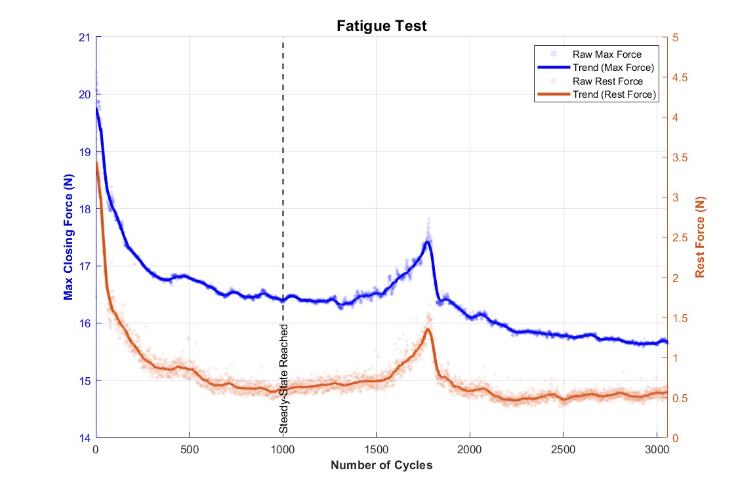
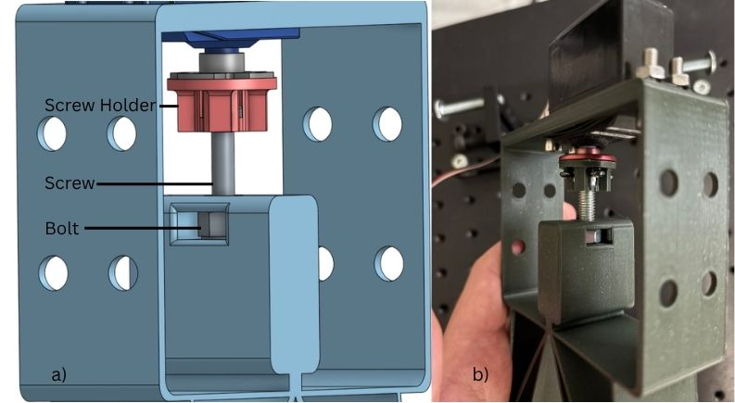
Work Completed
- Progress on the report
Metal Transmission Gripper
Fatigue Test : PLA Transmission

Slide 4
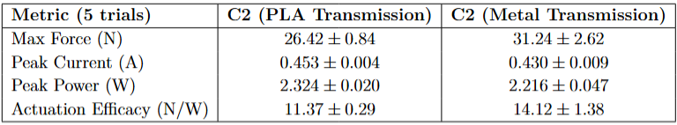
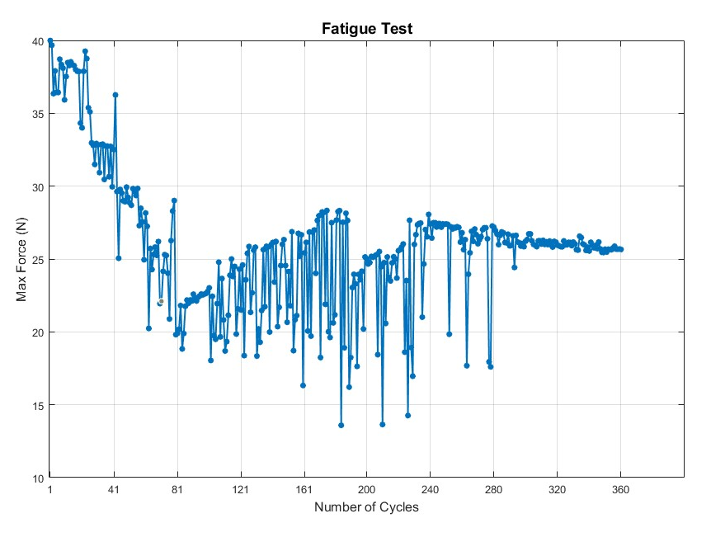
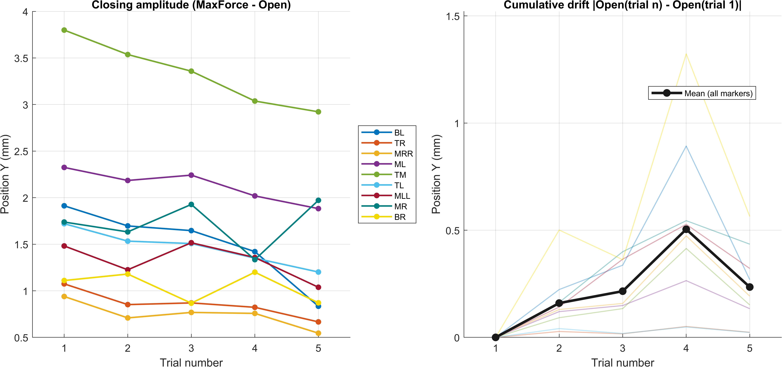
Work Completed
Test A Results
Hysteresis and Cumulative Drift (5 trials) on C2 Metal Transmission
Fatigue Test : Metal Transmission

Slide 5
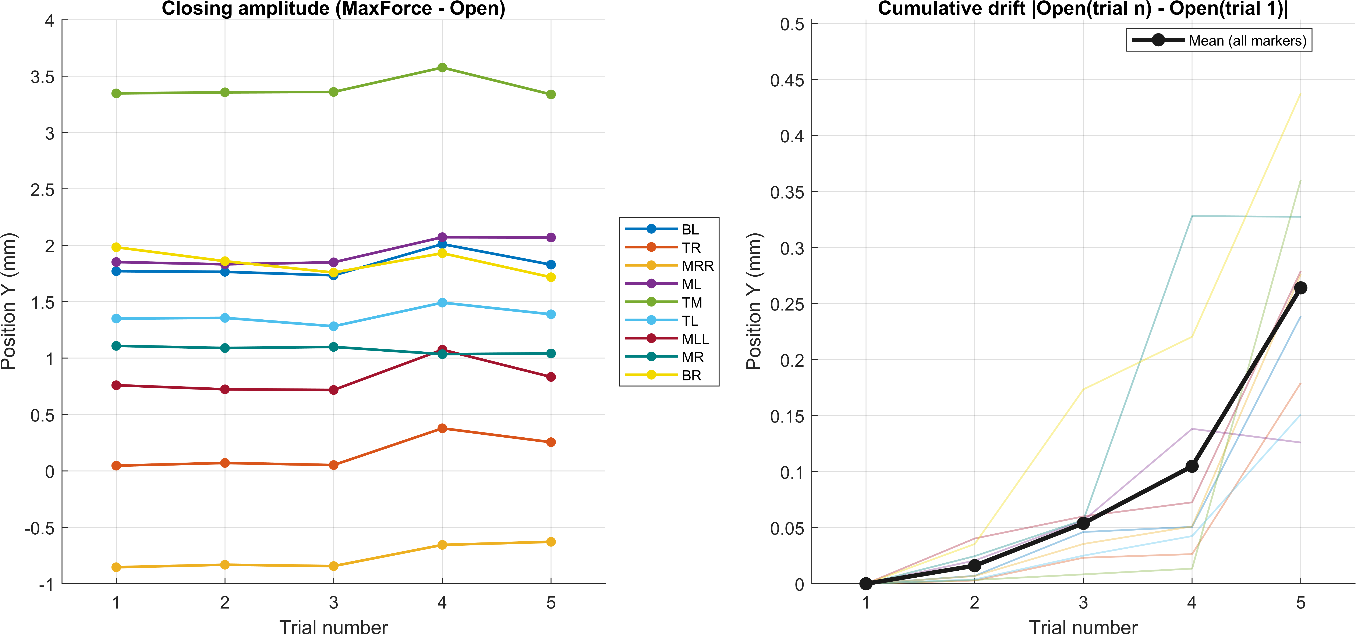
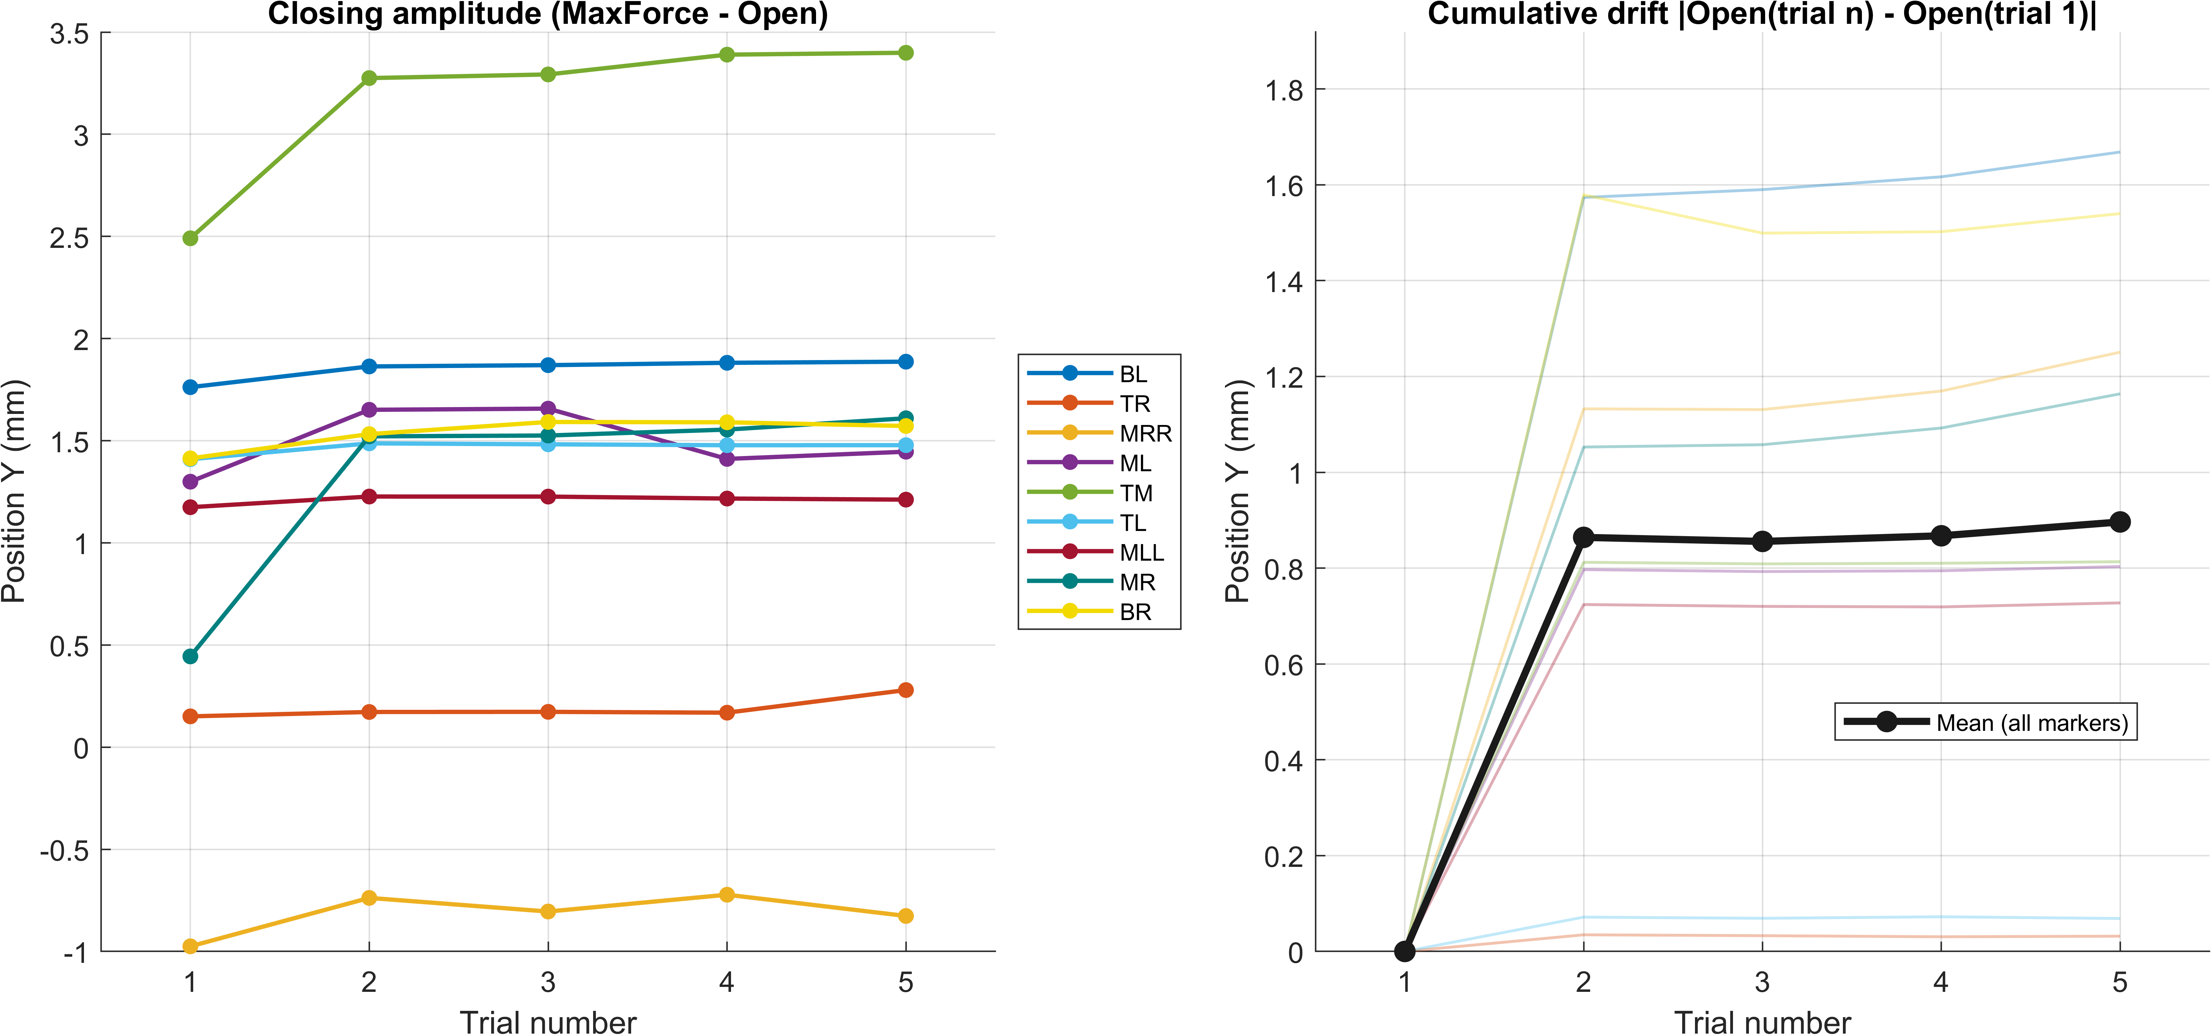
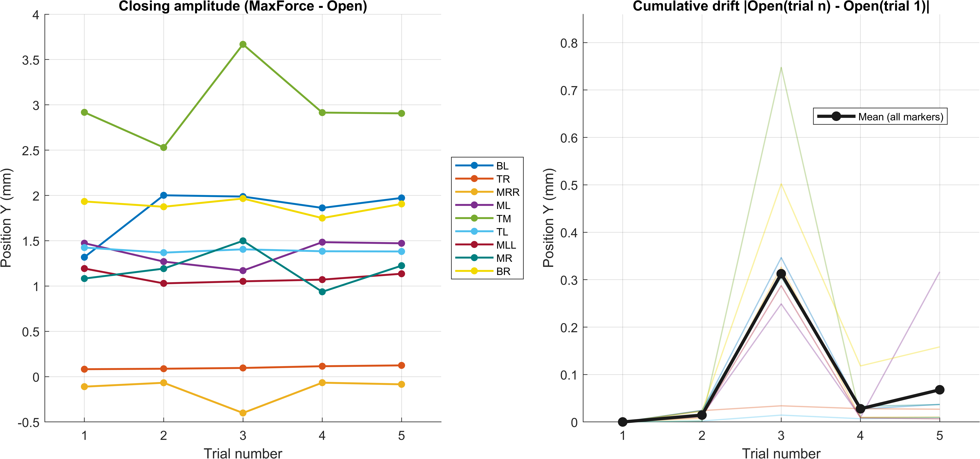
Work Completed
Hysteresis and Cumulative Drift (5 trials) on C1 PLA Transmission
Hysteresis and Cumulative Drift (5 trials) on C2 PLA Transmission
Hysteresis and Cumulative Drift (5 trials) on C3 PLA Transmission

Slide 6
Problems/Challenges
Fatigue Test with Metal Transmission are very long and I can't automate them because there is mechanical buckling. At maximum torque, the tension causes the connections (between TL/MLL and TR/MRR) to bend into a U-shape. This deformation sometimes creates a blockage when the motor attempts to open the gripper due to the reversal of force vectors. Unlocking requires jerky joystick movements to overcome this anomaly.

Slide 7
Admin
x

Slide 8
Tyndall National Institute,
Lee Maltings,
Dyke Parade,
Cork,
Ireland.
T12 R5CP
t: +353 21 490 4177
e: info@tyndall.ie
tyndall.ie
@tyndall-national-institute @TyndallInstitut
@tyndall_institute
@TyndallInstitute

